Slide 1
Marine AI Expert System
Muhammad Israr | Subject: AI

Slide 2

Presentation Roadmap
Introduction: What is an Expert System?
Problem Statement: The Need for Marine AI
System Components: Facts, Rules & User Input
Engine 1: Forward Chaining (Prediction)
Engine 2: Backward Chaining (Confirmation)
Core Algorithms: How We Search (BFS, DFS, A*)
Conclusion & Future Work

Slide 3

What is an Expert System?
An Expert System is an AI program that simulates the judgment and behavior of a human expert in a specific domain.
Our project uses this approach for Marine Science.
Goal: To build a system that can identify marine life or diagnose ecosystem health (like coral bleaching) based on visual observations.
Insert Image (e.g., Lionfish)

Slide 4

The Challenge in Marine Science
The Problem
The Solution
How can we quickly and accurately identify species or diagnose conditions from a vast set of possibilities? Field experts are rare, and identification guides are slow.
A Knowledge-Based System that captures expert logic. It provides rapid, accessible, and consistent answers by reasoning over known facts.

Slide 5

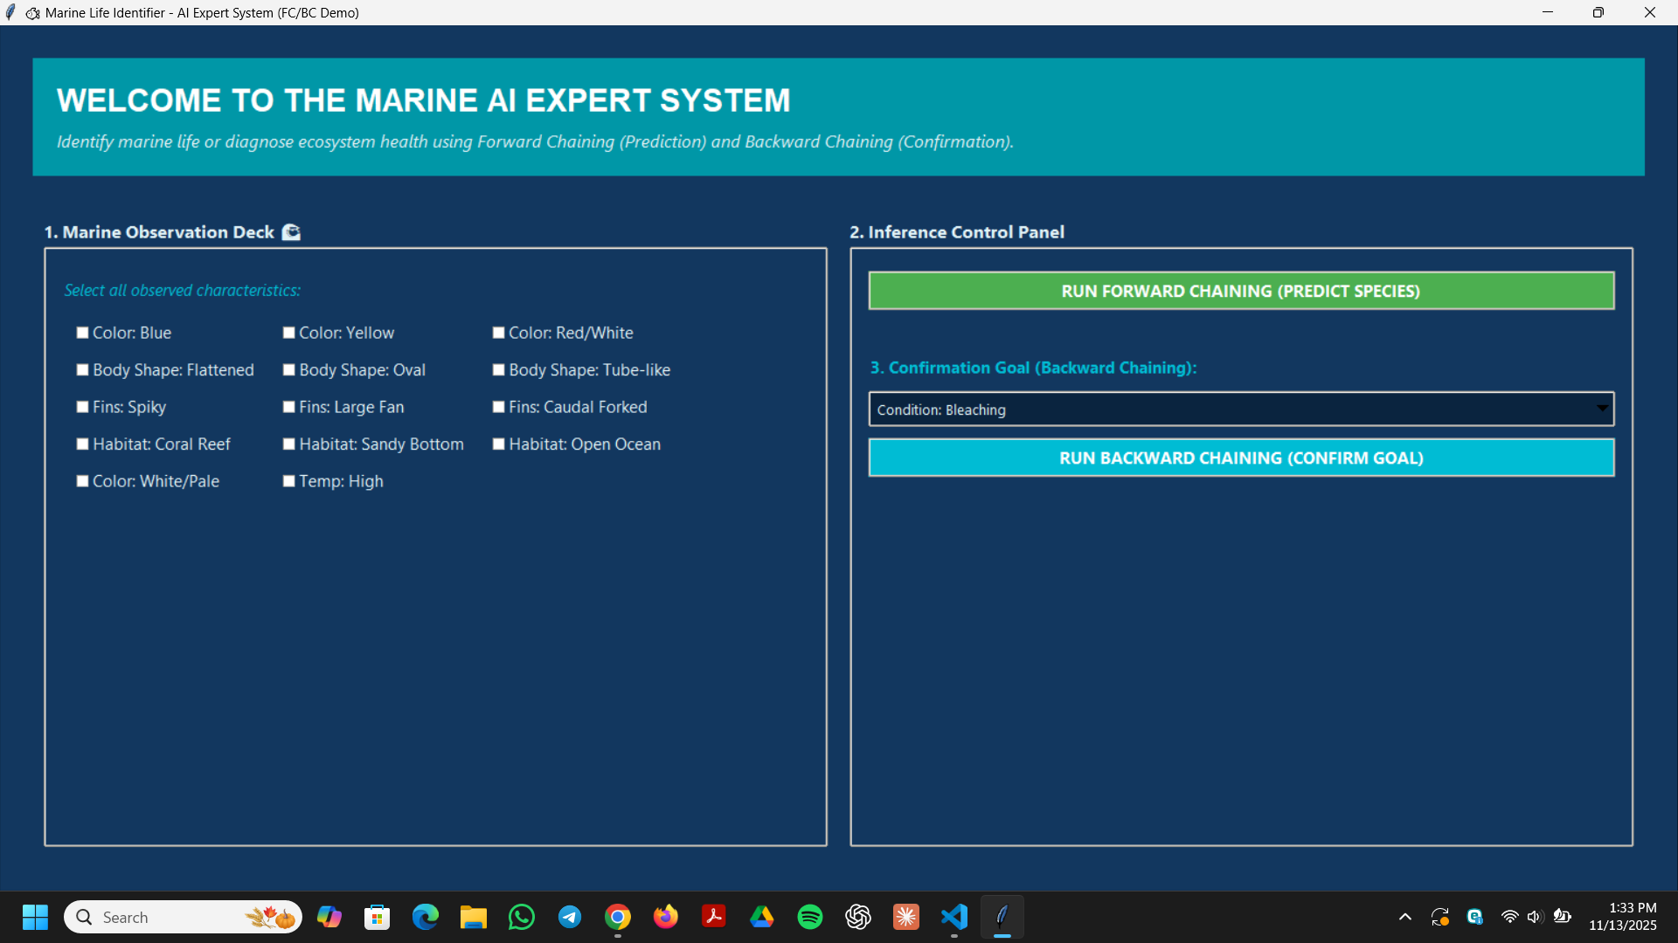
User Input: The Facts
The system starts with observations from the user. We built a GUI with Tkinter for this.
Insert GUI Screenshot
The user selects checkboxes, which become the initial "Fact Base" for the AI.
Examples: "Color: Blue," "Fins: Spiky," "Habitat: Coral Reef."

Slide 6




The Building Blocks: Facts
Definition
Example
Role
Facts are the basic, undeniable truths in our system's "Working Memory."
initial_facts = ['Color: Red/White', 'Fins: Spiky']
They are the starting points (user input) that the AI uses to begin its reasoning process.

Slide 7

The "Brain": The Rule Base
The Concept (IF-THEN)
The Code (Python)
Rules represent the "Knowledge Base." They are the IF-THEN logic statements provided by a human expert.
RULES = [
('Species: Lionfish',
IF [condition 1] AND [condition 2]... THEN [conclusion]
['Color: Red/White', 'Fins: Spiky', 'Habitat: Coral Reef'])
]

Slide 8
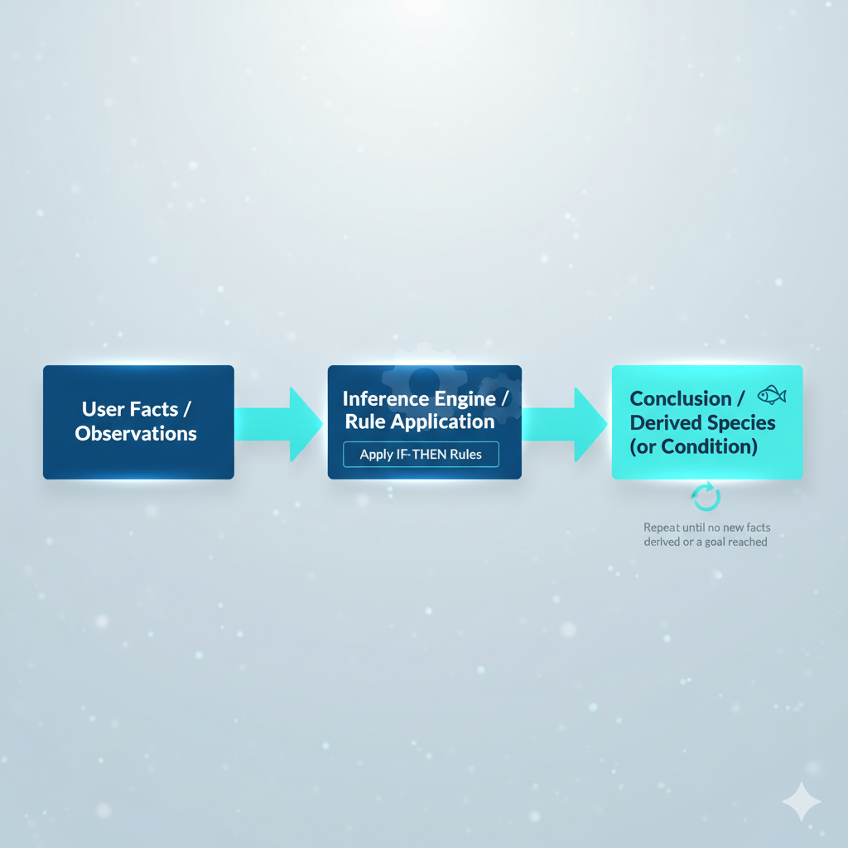
Prediction: Forward Chaining
Concept: Data-Driven
Starts with known facts and chains forward to a conclusion.
How it Works:
1.
Start with user-input facts.
2.
Find a rule where the "IF" part is matched by the facts.
3.
"Fire" the rule, adding its "THEN" part as a new fact.
Insert Forward Chaining Flowchart
4.
Repeat until a final goal is found.

Slide 9
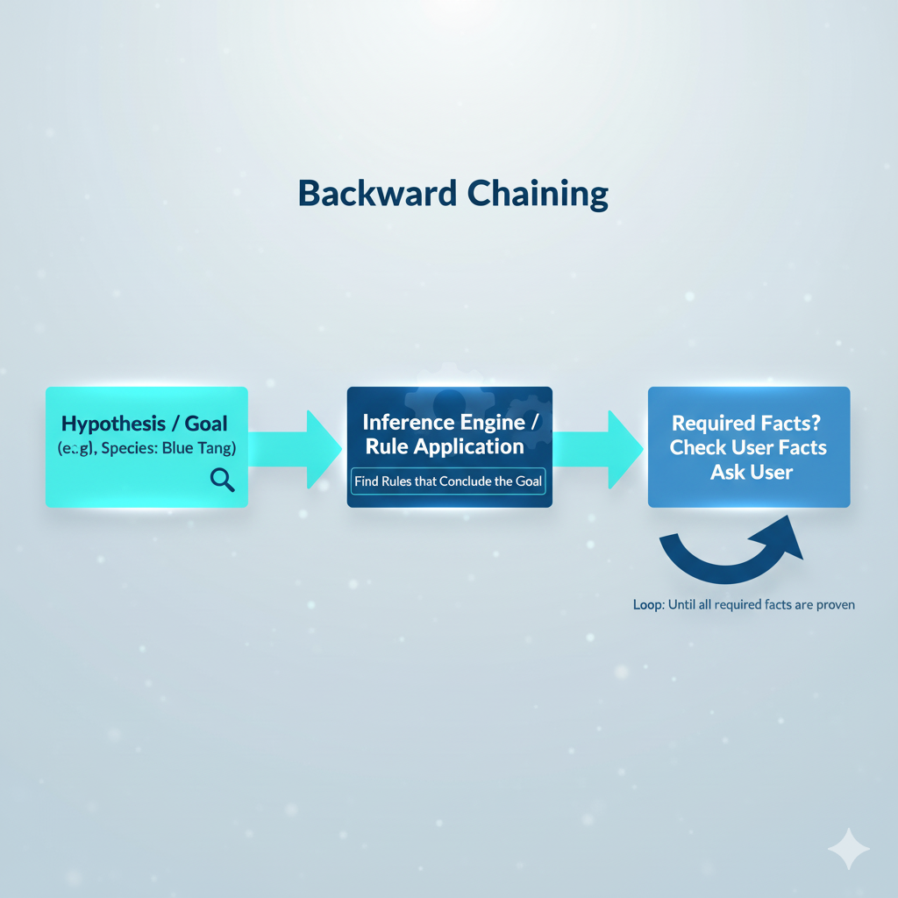
Confirmation: Backward Chaining
Concept: Goal-Driven
Starts with a hypothesis (goal) and works backward to see if facts support it.
How it Works:
1.
Start with a Goal (e.g., "Is it a Blue Tang?").
2.
Find a rule that concludes this goal.
Insert Backward Chaining Flowchart
3.
Check the "IF" parts. Are they known facts?
4.
If not, treat them as new sub-goals and repeat.
5.
If all sub-goals are proven, the hypothesis is TRUE.

Slide 10




How the Engine *Searches* for Rules
BFS (Breadth-First)
DFS (Depth-First)
Heuristics (A*, Greedy)
Used in our Forward Chaining. It explores all rules at one level before going deeper, finding the most direct path.
Used in our Backward Chaining. It dives deep down one path to prove a sub-goal, perfect for verifying a hypothesis.
The next step. These would use "best-guess" logic to search the most likely rules first, making the system faster.

Slide 11
Conclusion & Future Work
Achievement: Successfully built a functional Marine AI Expert System in Python.
Demonstrated: Integrated a GUI (Tkinter) with two core AI reasoning engines (FC and BC).
Key Learning: Showed how search algorithms (BFS, DFS) are the engine that powers rule-based AI.
Future Work: Expand the rule base, add a "Why?" feature (explanation), and implement heuristic searches (A*) for optimization.

Slide 12
Questions?
Thank you for your attention.

Slide 13
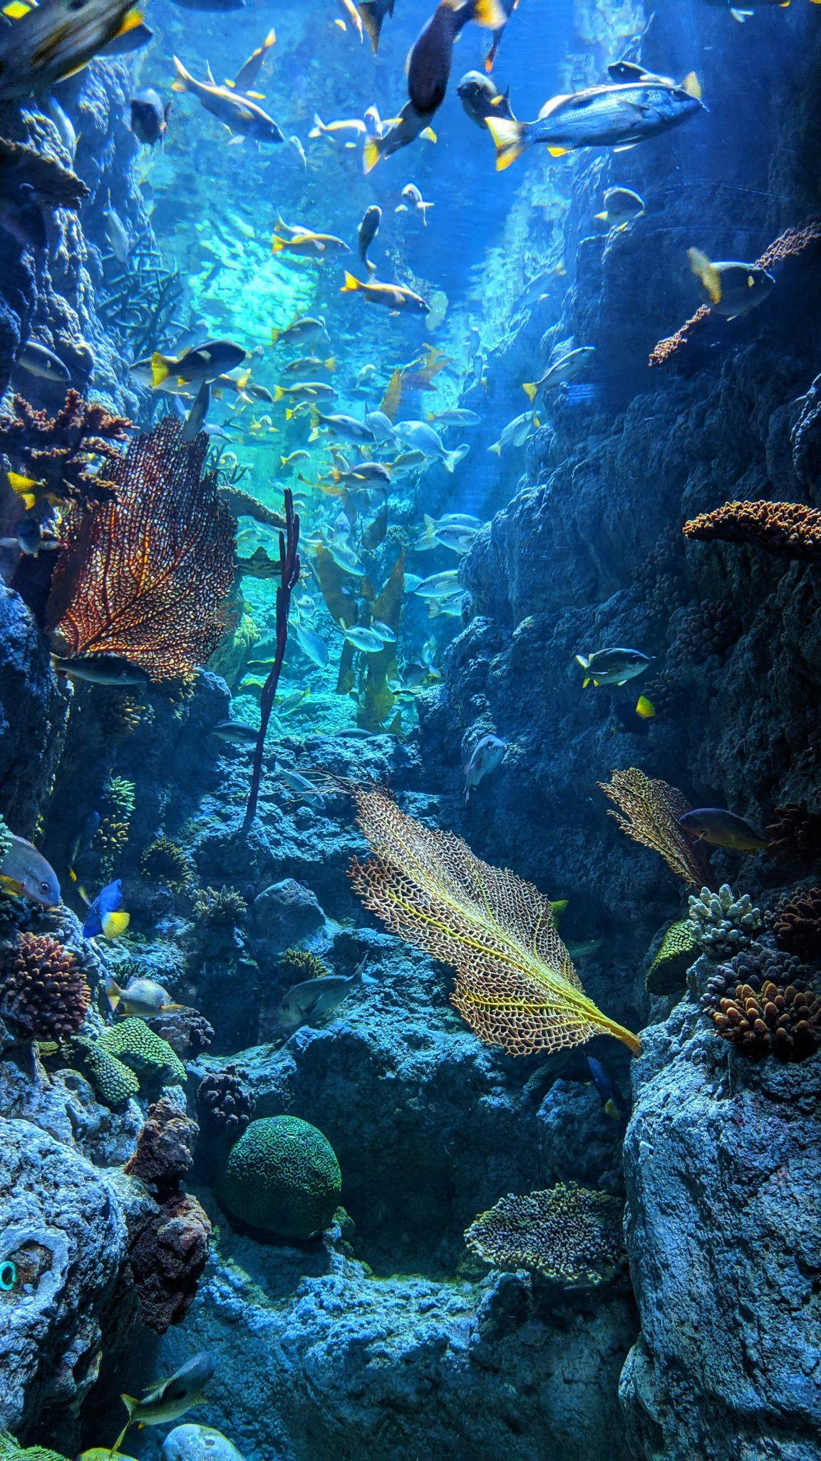
Thank You
Muhammad Israr | Subject: AI

